Slide 1
Group 3 Project 2
Jance Ng
Jin Min Wood
Adrian Kong

Slide 2
PROBLEM STATEMENT
As a property agency, it is very important to us that we are able to estimate what is the estimated worth of the property. By predicting the worth of a property accurately, we have higher confidence in selling the property and also receiving our well deserved commission. There are many manipulating variables that are affecting the price of a property. We will make use of regression model to estimate the SalePrice of a property and measure how well is our prediction and the actual SalePrice.

Slide 3
DATASET
Number of features: 81; examples below:
Area of the House | Data Column (Feature) | Data Description
Bathroom | bsmt_full_bath | Basement full bathrooms
 | bsmt_half_bath | Basement half bathrooms
 | full_bath | Full bathrooms above grade
 | half_bath | Half baths above grade
Kitchen | kitchen_abvgr | Kitchens above grade
 | kitchen_qual | Kitchen quality
Fireplace | fireplaces | Number of fireplaces
 | fireplace_qu | Fireplace quality
For more information, please refer to: http://jse.amstat.org/v19n3/decock/DataDocumentation.txt)

Slide 4
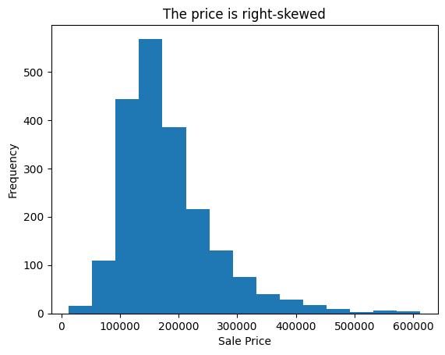
EXPLORATORY VISUALIZATION

Slide 5
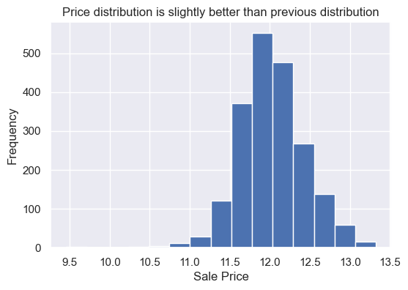
Convert Sale Price to logarithmic scale: log(saleprice)

Slide 6
DATA CLEANING - Missing Values
Feature | Remarks
Alley | It can be deduced that there is no alley access.
Bsmt Qual | The missing value count is the same as Bsmt Cond, it can be deduced that there is no basement for these units.
Bsmt Cond | Same as Bsmt Qual.
Garage Type | We can assume these houses have no garage.
Pool QC | We have no other reference, hence we will assume there is no pool.

Slide 7
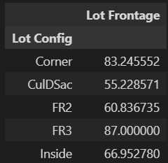
DATA CLEANING - Missing Values - Exception 1
Feature | Remarks
Lot Frontage | We can assume that the unit is an apartment or condominium so it does not have lot frontage. However, looking through the MSSubclass, there is no apartment or condominium. Therefore, we will need to replace the missing values with the mean of the Lot Frontage.
Mean Value

Slide 8
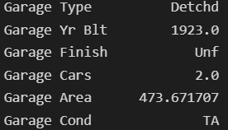
DATA CLEANING - Missing Values - Exception 2
Feature | Remarks
Garage Yr Blt | There is one house with value in under Garage Type but has missing garage year built. We replace missing value under numerical column with the mean value and missing value under categorical column with mode value

Slide 9
PREPROCESSING
Split dataset into numerical and categorical features.
One-hot encode all categorical features.
Merge all numerical and the one-hot encoded categorical features
Split the dataset into 80% train and 20% test
Data | Number of rows | Number of columns
X_train | 1640 | 274
X_test | 411 | 274
y_train | 1640 | 1
y_test | 411 | 1

Slide 10
BASELINE MODEL
Model Used | Linear Regression
Features Used | Lot Area & Overall Quality
R2 score | 0.7142968805431572

Slide 11
MODELING PART 1
Steps:
Standardize all features
Fit standardized features to Linear Regression model.
Model Used | Linear Regression
Features Used | Standardized all features
R2 score | -4.6009062687285534e+21

Slide 12
MODELING PART 1 (cont.)
Steps:
Find optimal alpha value
Fit standardized features to Ridge model with optimal alpha value.
Model Used | Ridge
Features Used | Standardized all features
R2 score | 0.8397908717781926
RMSE | 199325.9060718847

Slide 13
MODELING PART 1 (cont.)
Steps:
Find optimal alpha value
Fit standardized features to Lasso model with optimal alpha value.
Model Used | Lasso
Features Used | Standardized all features
R2 score | 0.8437015234296557
RMSE | 199147.08628262393

Slide 14
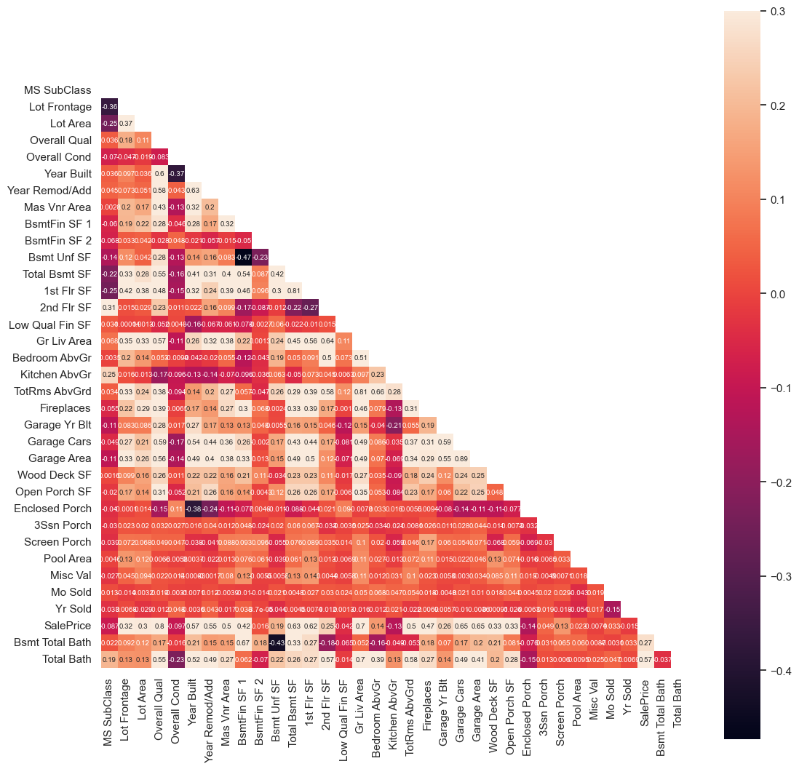
DATA PROCESSING PART 2
Heatmap of correlation of all numerical features.

Slide 15
FEATURE | VIF
Overall Qual | 60.667728
Year Built | 9058.56774
Year Remod/Add | 8910.26204
Mas Vnr Area | 1.85017
Total Bsmt SF | 22.201645
1st Flr SF | 34.998552
Gr Liv Area | 59.79677
TotRms AbvGrd | 55.854408
Garage Cars | 36.763833
Garage Area | 32.589563
SalePrice | 28.860521
Total Bath | 22.967767
These are the features with correlation to SalePrice higher than 0.5
Year Built and Year Remod/Add has high Variance Inflation Factor

Slide 16
Final features selected in Part 2 are:
Overall Qual
Mas Vnr Area
Total Bsmt SF
1st Flr SF
Gr Liv Area
TotRms AbvGrd
Garage Cars
Garage Area
Total Bath
Age

Slide 17
MODELING PART 2
Steps:
Standardize all features selected in Data Processing Part 2
Fit standardized features to Linear Regression model.
Model Used | Linear Regression
Features Used | Standardized features selected in Part 2
R2 score | 0.7702069554872076
RMSE | 129467.33485416573

Slide 18
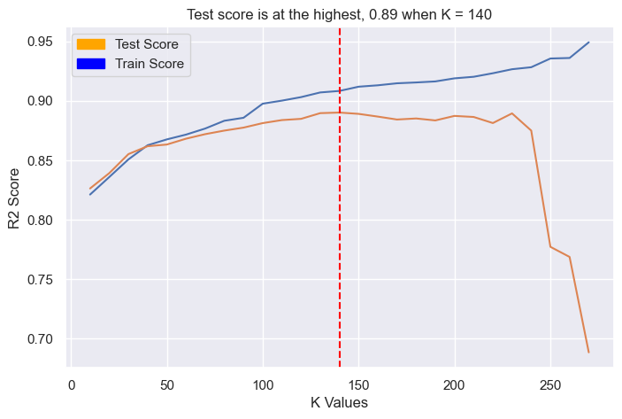
MODELING PART 3 (With SelectKBest)

Slide 19
MODELING PART 3
Steps:
Make use of SelectKBest function to select optimum number of features, K.
Fit and transform the training data with K number features.
Fit transformed data to Linear Regression model.
Model Used | Linear Regression
Features Used | 140 features selected with SelectKBest function
R2 score | 0.890137859811365
RMSE | 23914.714072188213

Slide 20
CONCLUSION
Model | In Section | R2 Score | RMSE
Linear Regression | Baseline Model | 0.7142968805431572 | Not Calculated
Linear Regression | Modeling Part 1 | -4.6009062687285534e+21 | Not Calculated
Ridge | Modeling Part 1 | 0.8397908717781926 | 199,325.9060718847
Lasso | Modeling Part 1 | 0.8437015234296557 | 199,147.08628262393
Linear Regression | Modeling Part 2 | 0.7702069554872076 | 129,467.33485416573
Linear Regression | Modeling Part 3 | 0.890137859811365 | 23,914.714072188213
The method and model in Modeling Part 3 gave us the best R2 score and RMSE. This model will be used to predict house sale price.

Slide 21
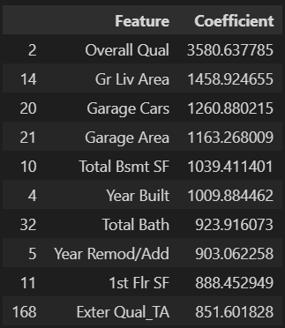
Top 10 Features

